Slide 1
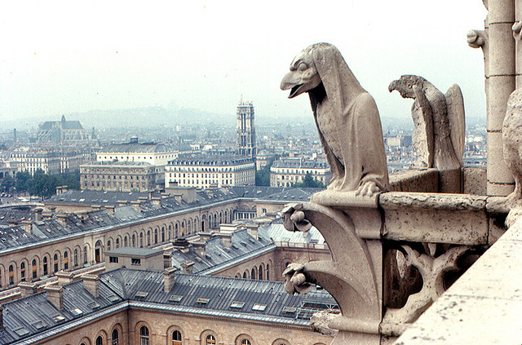
Welcome to Paris 1789
Revolution is in the air!

Slide 2
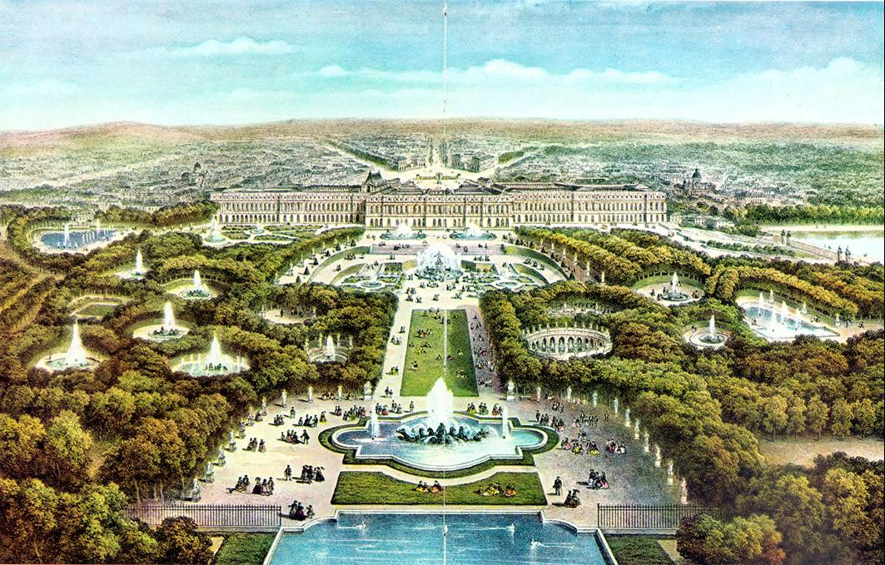
Why was there a Revolution in France 1789?
Learning Objective:
To know the causes of Revolution in French society in the 1700s.
Success Criteria:
I can describe the structure of French society in the 18th Century
I can explain some of the reasons that caused the French revolution.
I can explain how the different estates reacted in different ways leading up to the French Revolution.

Slide 3
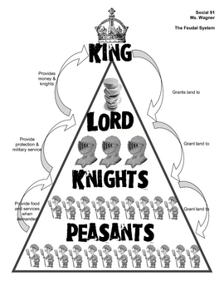
Spot the difference
Few
Richer
English Medieval Feudal System
Many
Poorer

Slide 4
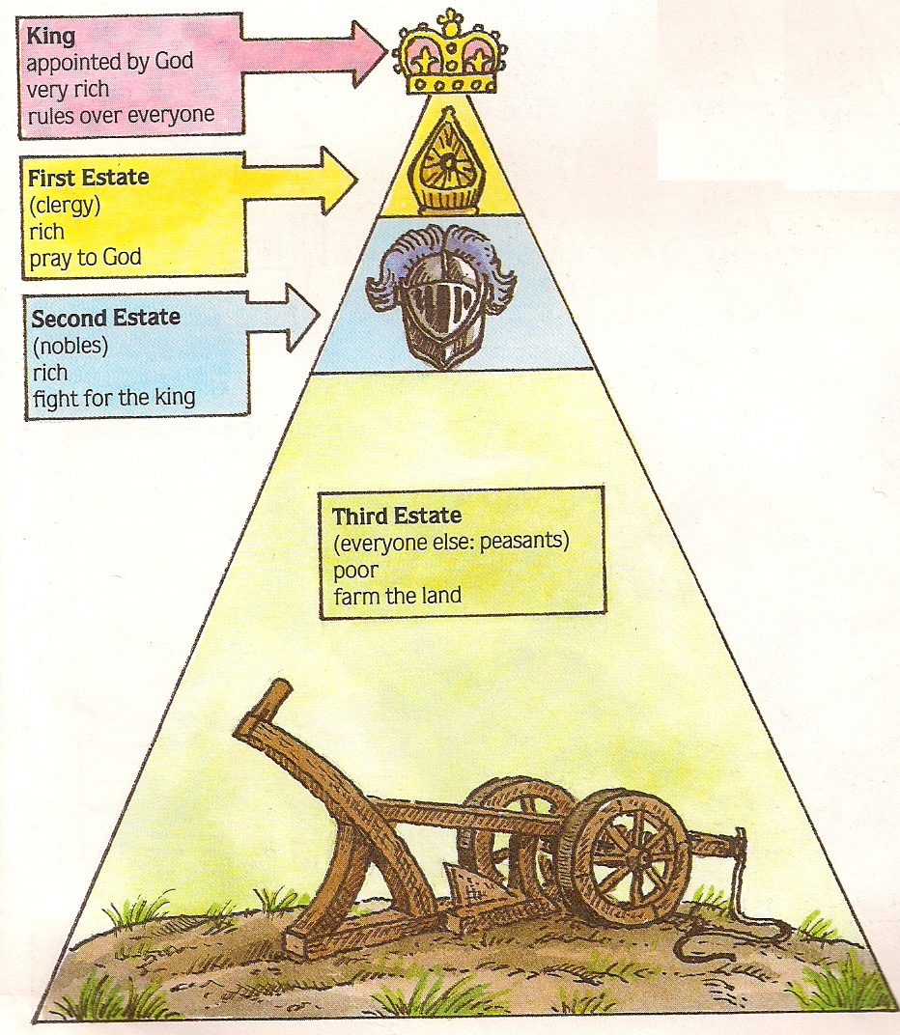
Few
Richer
10% of population
90% of population
French Society 1700
Many
Poorer

Slide 5
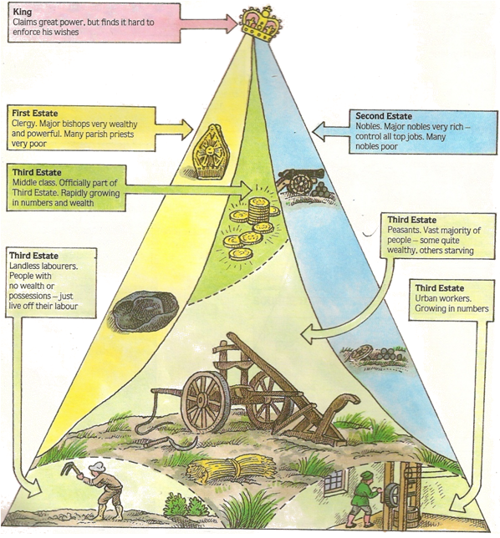
Few
Richer
French Society late 1700s
Many
Poorer

Slide 6
Welcome to the French
Revolution game
Your will be assigned a particular role during the game. These are as follows...
King Louis XVI – One person, you are above everyone.
Queen Marie – One person, you stay by the side of the king.
Army – Two people (Your job is to arrest those that don’t pay taxes and put them in the Bastille)
First Estate – One person as the rich Cardinal Rohan, two as poor but sympathetic priests
Second Estate – three people, all very posh!
Third Estate – ten to fifteen people, you are poor peasants. Choose a spokes person.
Banker – You work for the king and take in the taxes (Also called the teacher!)

Slide 7
King Louis XVI
You own the bank!
First Estate
Cardinal Rohan – start with 5 coins
2 people – start with 3 coins
Second Estate
2 people – start with 5 coins
1 person – starts with 3 coins
Third Estate – Middle Class
1 person starts with 4 coins
Third Estate – Peasants
Start with 3 coins
The banker and the army will give out your money as noted above before our French Revolution game begins.
French Revolution game

Slide 8
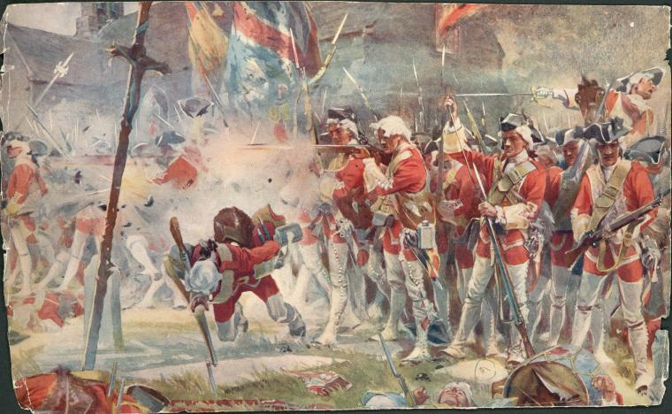
Turn 1
Seven Year War
1756-1763
France fights a very expensive war against its old enemy, the British.
This bleeds away the French revenues leaving the country very poor. The Third estate is taxed.
3rd pays – 1 gold coin

Slide 9
Turn 2
American wars
1775-1783
During the American wars of independence, France sided with the colonists and against Britain. The King charged his people a massive tax to aid the Americans. The third estate footed the bill.
3rd pays – 1 gold coin

Slide 10
Turn 3
Tax Reform
1787
France went bankrupt.
The King tried to reform the tax system to make the second estate pay. They refuse to pay but he forced some money from them. It wasn’t enough and the country went into 4000 million livres (£1000M) debt.
The Second estate despised the king.
2nd pays – 2 gold coins
3rd pays – 1 gold coin

Slide 11
Turn 4
Bad Harvest
1788
In 1788 the harvest in France failed. This caused widespread despair especially to the third estate who had to give most of what they had to the second.
This forced up the price of bread. Many starved to death.
3rd pays – 1 gold coin to the King
3rd pays – 1 gold coin to the 2nd Estate

Slide 12
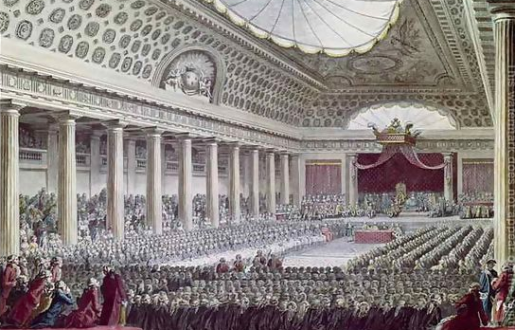
Turn 5
Estates general
August 1788
The king called a meeting of the Estates General. This was where each estate was represented. The king wanted to make everyone pay more tax, even the Church. He even used the army to threaten everyone there. The representatives were furious and refused to follow the king.
3rd pays – 1 gold coin to the King
2nd pays – 2 gold coin to the King
1st pays – 2 gold coins to the King

Slide 13
Turn 5
Estates general
August 1788
The king called a meeting Estates General. This was where each estate was represented. The king wanted to make everyone pay more tax, even the Church. He even used the army to threaten everyone there. The representatives were furious and refused to follow the king.
Now report back.
How do you feel about the king?

Slide 14
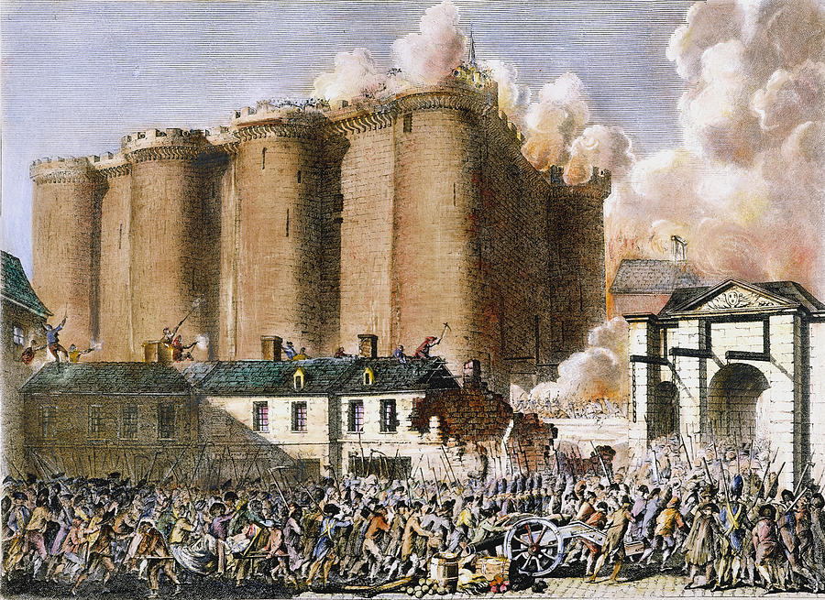
Breaking point came on 14th July 1789. The third estate was fed up with the king and his taxes. They attacked the Bastille prison and broke out the prisoners. This was an attack against the king’s authority and was the start of a nation wide revolution.

Slide 15
The Revolution has started! This is what we the people of the Revolution demand!!!!
To get rid of the King and all of the Royal family!
The rich will pay with their lives for the poverty of the people!
The country will become atheist. Religion is illegal!
All people have equal rights. No one is superior to anyone else.
Everyone has the right to the Guillotine.

Slide 16
Explain why the French Revolution began
Try to include the following:
A comment on how the different estates were treated by the king
A comment on what makes people pay more tax
Your judgement on what you think caused the French Revolution

Slide 17
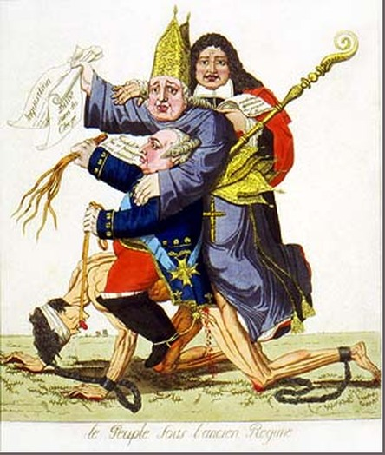
Can you work out the meaning of this contemporary cartoon?

