Slide 1
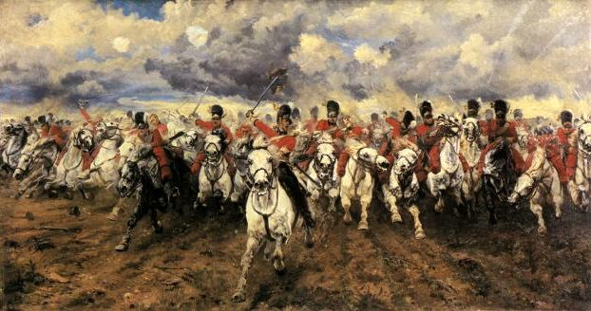
What happened at the Battle of Waterloo?
LO: to place the sequence of events of the Battle of Waterloo in chronological order
LO: to explain the outcome of the battle
LO: to evaluate the reasons for the outcome of the battle

Slide 2
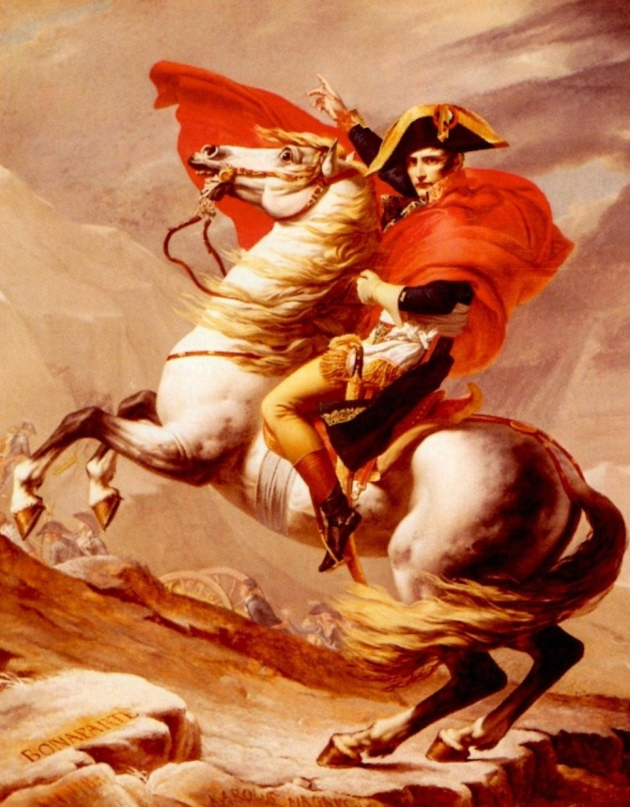
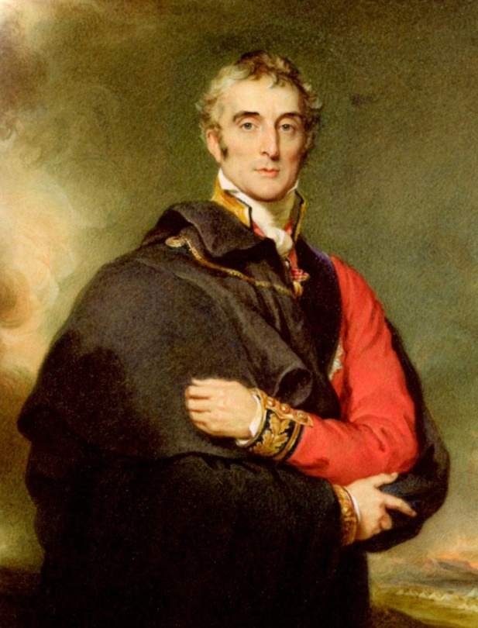
Napoleon v Wellington
What happened at the Battle of Waterloo?
To place the sequence of events of the Battle of Waterloo in chronological order
To explain the outcome of the battle
To evaluate the reasons for the outcome of the battle
Napoleon came back from exile not having changed what he wanted in Europe
The Duke of Wellington was Napoleon's arch enemy and commander of the British army

Slide 3
The Battle: version 1
What happened at the Battle of Waterloo?
To place the sequence of events of the Battle of Waterloo in chronological order
To explain the outcome of the battle
To evaluate the reasons for the outcome of the battle
Napoleon managed to escape from exile and was up to his old tricks again.
He needed to be dealt with once and for all. After a hard fought battle Wellington and his army were successful but was this because of Wellington’s brilliance or Napoleon’s mistakes
http://www.youtube.com/watch?v=5Go5nlOCqi4

Slide 4
The Battle: version 2
What happened at the Battle of Waterloo?
To place the sequence of events of the Battle of Waterloo in chronological order
To explain the outcome of the battle
To evaluate the reasons for the outcome of the battle
Napoleon managed to escape from exile and was up to his old tricks again.
He needed to be dealt with once and for all. After a hard fought battle Wellington and his army were successful but was this because of Wellington’s brilliance or Napoleon’s mistakes
Notes:
Role play

Slide 5
Task
What happened at the Battle of Waterloo?
To place the sequence of events of the Battle of Waterloo in chronological order
To explain the outcome of the battle
To evaluate the reasons for the outcome of the battle
Wellington won the Battle of Waterloo | General Chronology | Napoleon lost the Battle of Waterloo
In your book draw a table like the one above.
Place the stickers in the correct chronological order (hint: work the order out before you stick it in your book!)
As you stick them in place them in the correct column.

Slide 6
Task
What happened at the Battle of Waterloo?
To place the sequence of events of the Battle of Waterloo in chronological order
To explain the outcome of the battle
To evaluate the reasons for the outcome of the battle
Wellington won the Battle of Waterloo | General Chronology | Napoleon lost the Battle of Waterloo
11AM Napoleon orders his brother, Jerome, to attack the farm buildings of Hougoumont. This is to make Wellington send more soldiers to defend it, making his line weaker elsewhere for the main attack. | 3AM The Duke of Wellington wakes up and starts writing a letter to Blűcher (the Prussian General) urging him to join the British to fight Napoleon

Slide 7
Task Choice
What happened at the Battle of Waterloo?
To place the sequence of events of the Battle of Waterloo in chronological order
To explain the outcome of the battle
To evaluate the reasons for the outcome of the battle
Using the information in the table you must now do one of two things (you choose):
Write a paragraph saying what happened at the battle of Waterloo.
Write an evaluative answer explaining why you think Wellington won or Napoleon lost the Battle of Waterloo.

Slide 8
Why should we care about the Battle of Waterloo?

