Slide 1
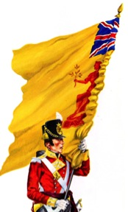
What was life like for a British soldier in 1815?
To identify the main components that made up the British army of 1815
To explain what the life of an infantry soldier was like

Slide 2
Waterloo (released in 1970)
Write down the different ‘jobs’ you can see the army doing in this battle.
Notes:
Show a clip of the end of the battle. Any two minute clip will do really – you’re just trying to gran their attention.

Slide 3
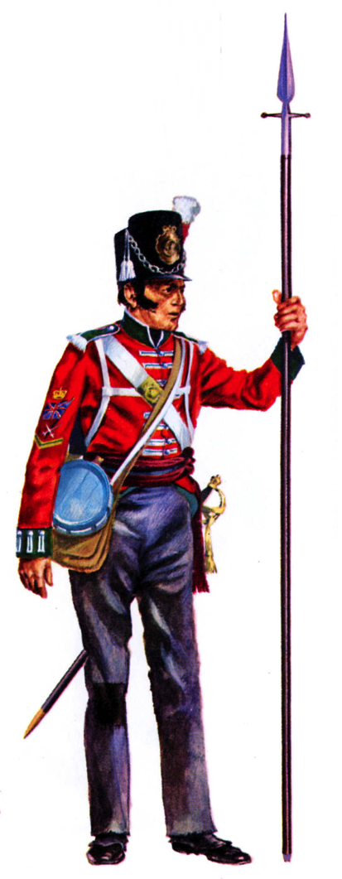
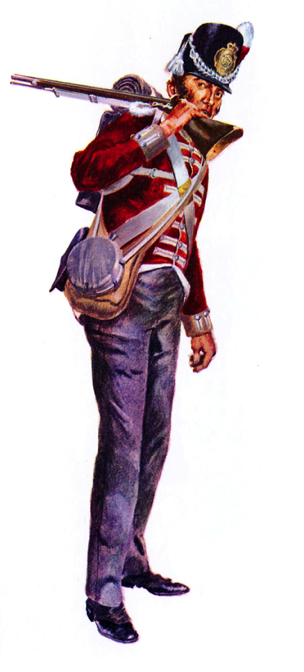
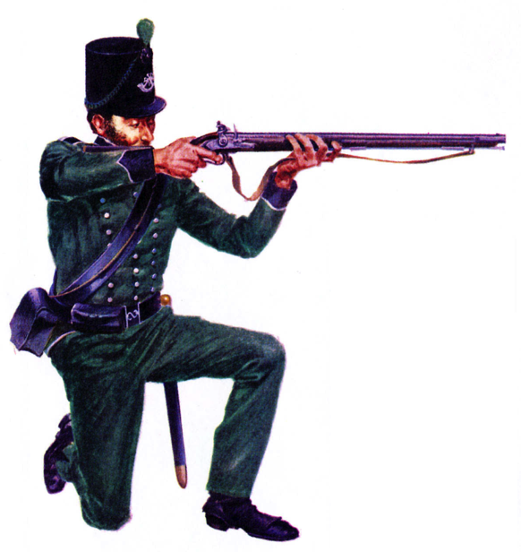
Infantry
Sergeant
Private
95th Rifleman

Slide 4
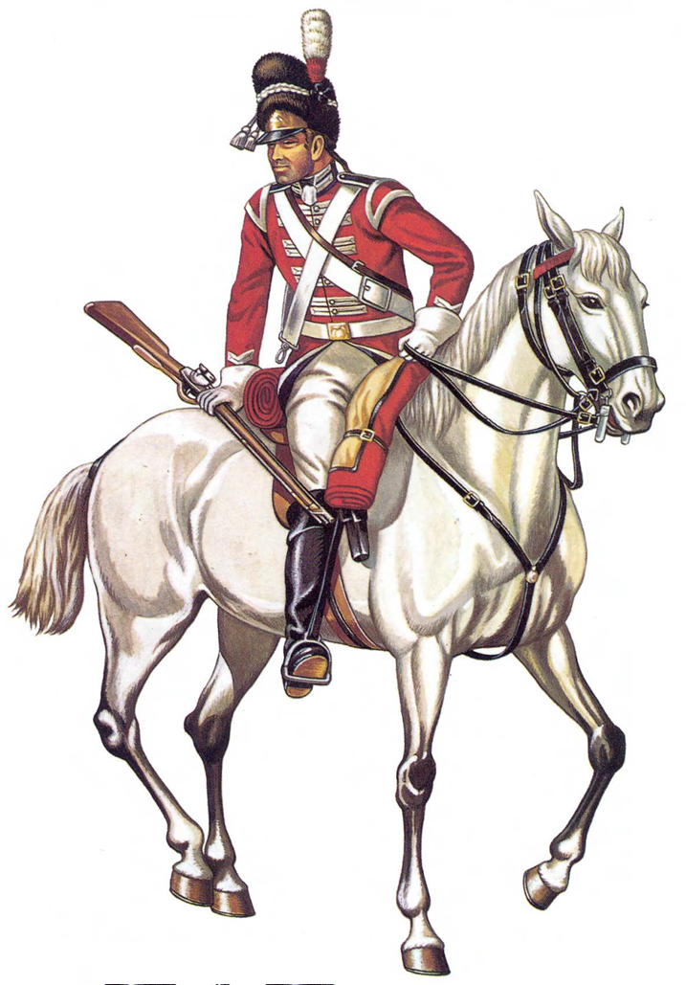
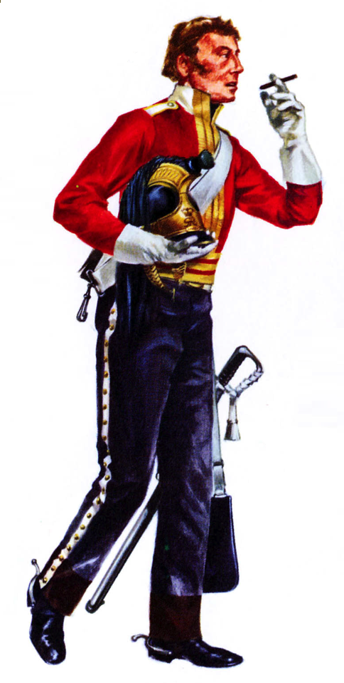
Cavalry
Trooper
Officer
Sergeant

Slide 5
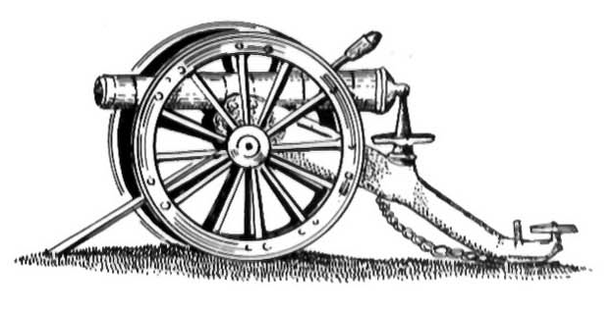
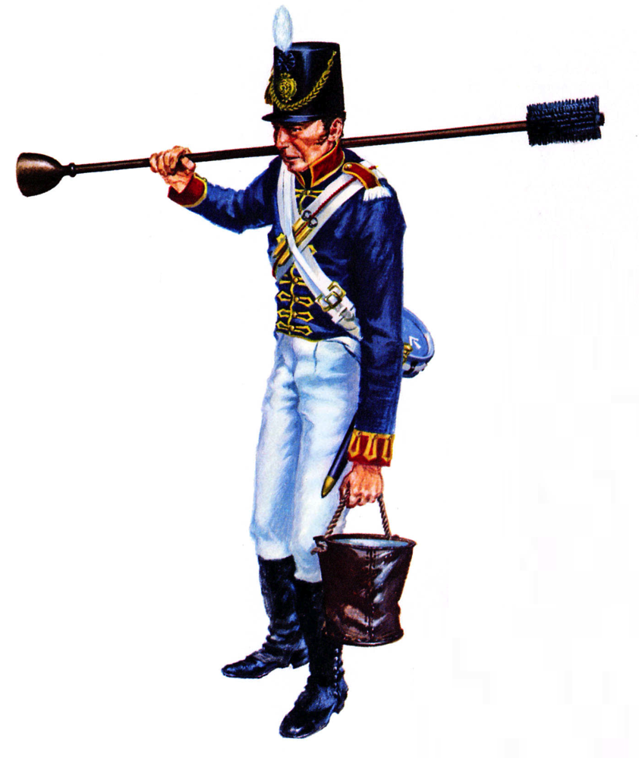
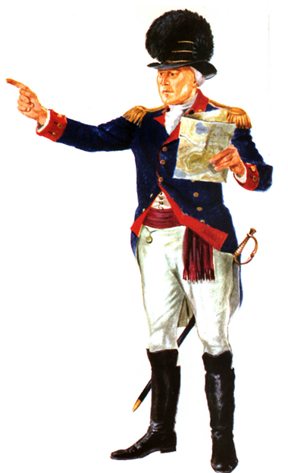
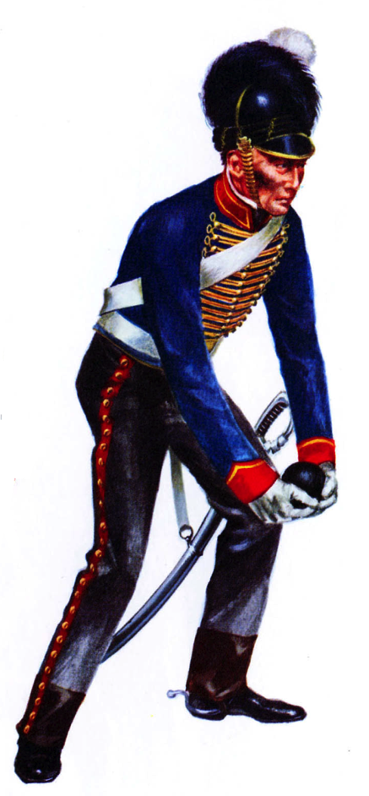
Artillery
Officer
Gunner
Gunner

Slide 6
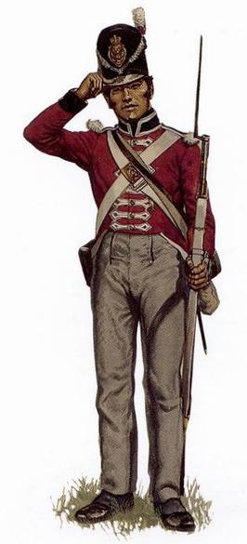
The Infantry regiments
Described by Wellington as being the ‘scum of the earth’.
These men fought on foot and were armed with a Brown Bess Musket. Many were from very poor backgrounds and army pay was far lower than most jobs in Britain.
They were given a uniform, new recruits got the hand downs.

Slide 7
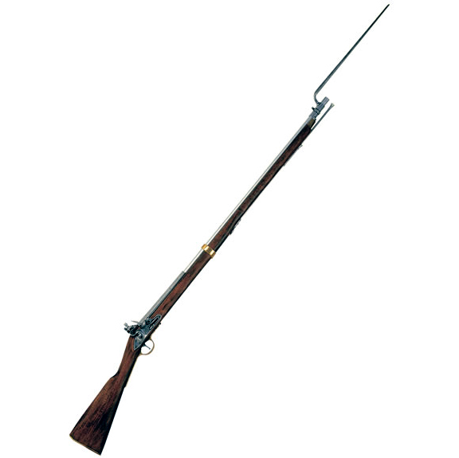
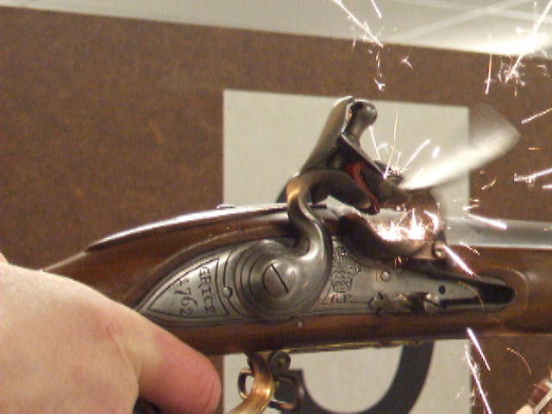
bayonet
The ‘brown Bess’

Slide 8
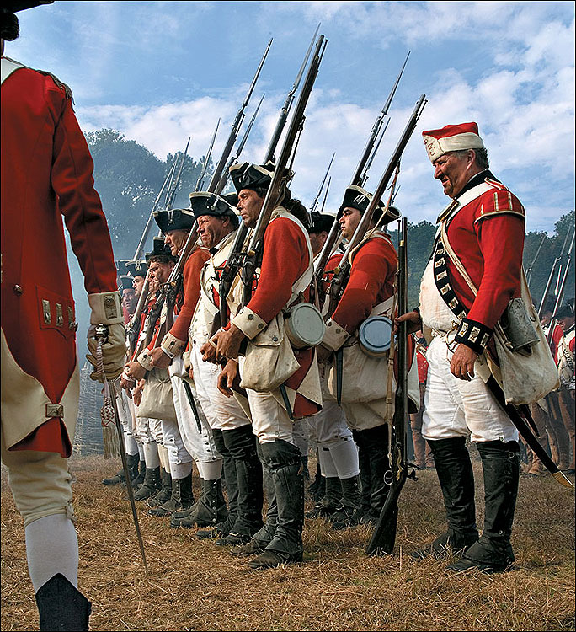
Line Formation

Slide 9
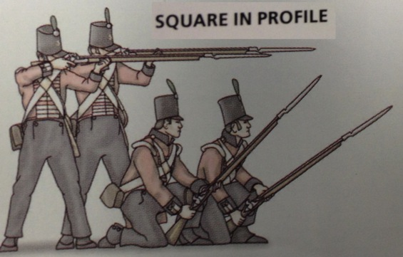
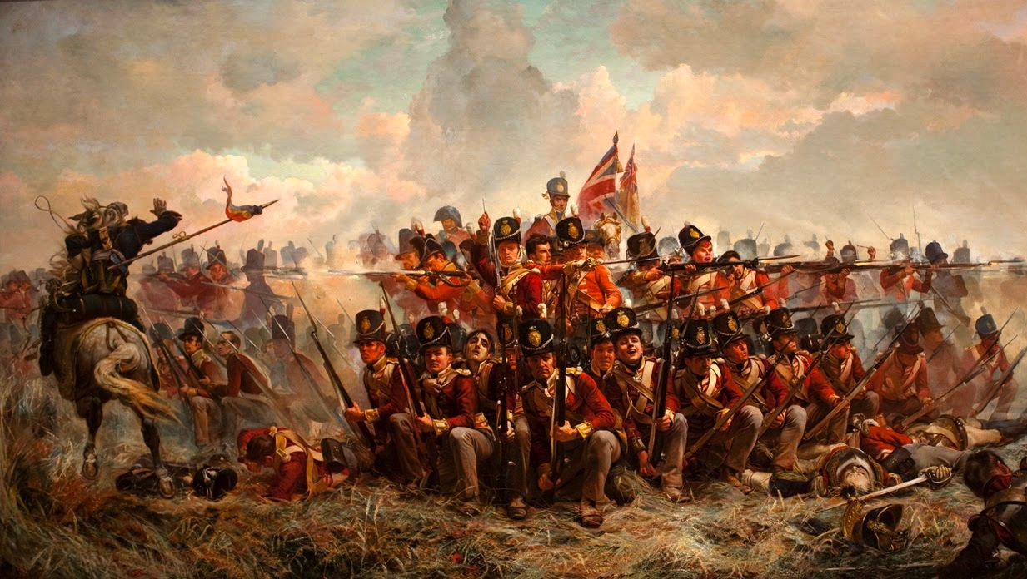
Square Formation

Slide 10
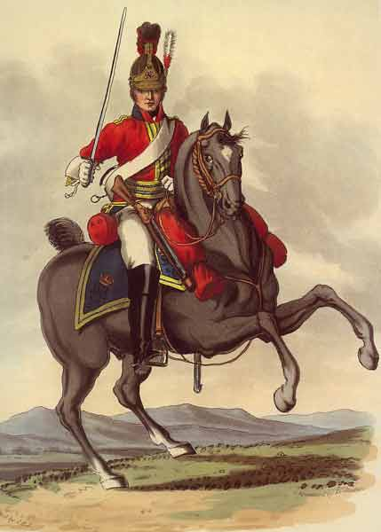
The Cavalry regiments
These are filled with the who’s who of 19th century Society.
As a cavalry soldier you were required to buy the most expensive uniform in the British Army.
You also had to purchase and look after your horse. If you were lucky then your colonel would buy these for you meaning you had to network to get noticed.

Slide 11
The Artillery regiments
These men were generally better educated or more intelligent than the average infantry soldier. Many were recruited because they stood out in their infantry units.
Their job was to maintain and fire the cannons during battle. This was a dangerous job and they were skilled at firing all of the cannon types in the army so that they could easily move where they were needed.

Slide 12
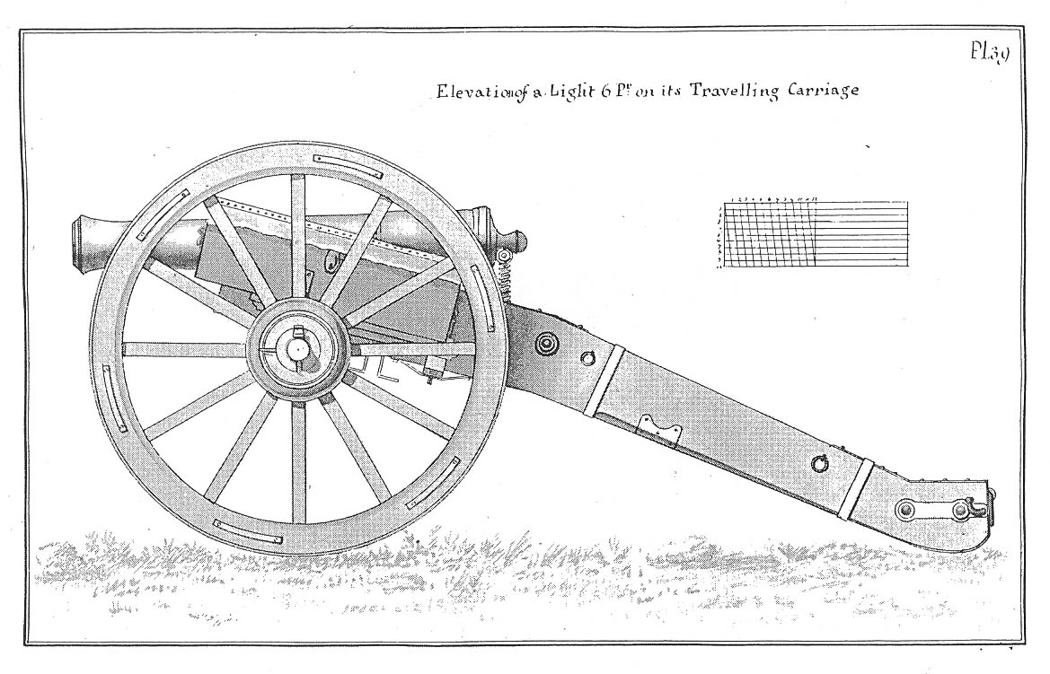
12 pounder cannon

Slide 13
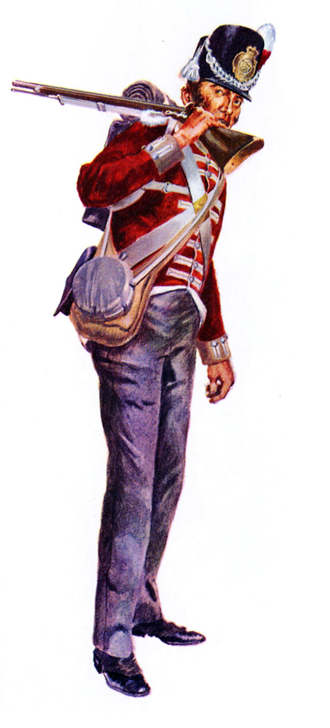
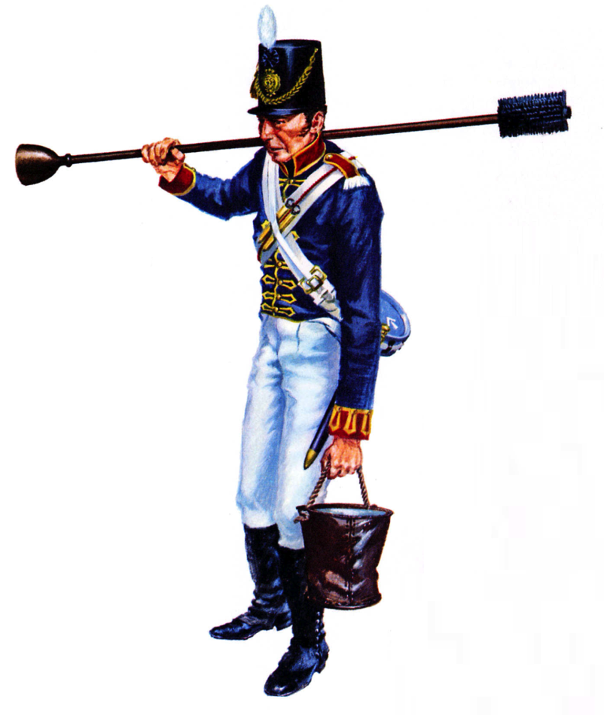
Private Sebastian Montague
Private Jack Smith
Gunner Frank Wright

Slide 14
What was life like for a Red Coat?
Make a table/mind map to collect the information about the daily life of a Red Coat. Include:
Daily routine
Your food
Weapons
Combat
Punishment
Use drawings if it helps.

