Slide 1
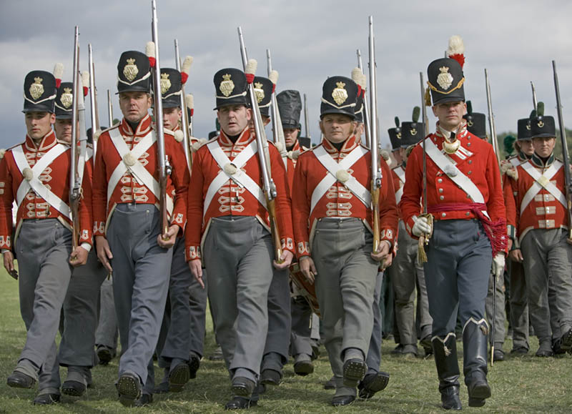
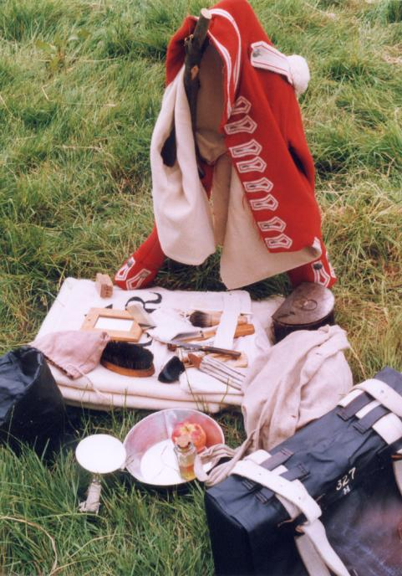
Uniform
Soldier! You are honoured to be able to wear our uniform. It consists of a red tunic, grey trousers, knapsack to keep all of your possessions, shako hat with regimental badge, black shoes, cartridge pouch with belt, bayonet belt. The last three have to be kept clean and polished. These will be inspected daily.
All of your kit will be inspected daily and if it isn’t up to scratch you will be fined and punished.

Slide 2
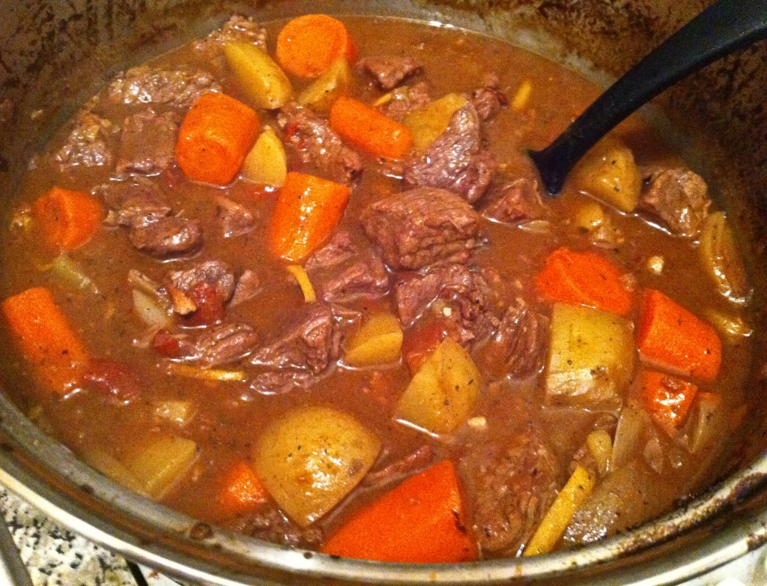
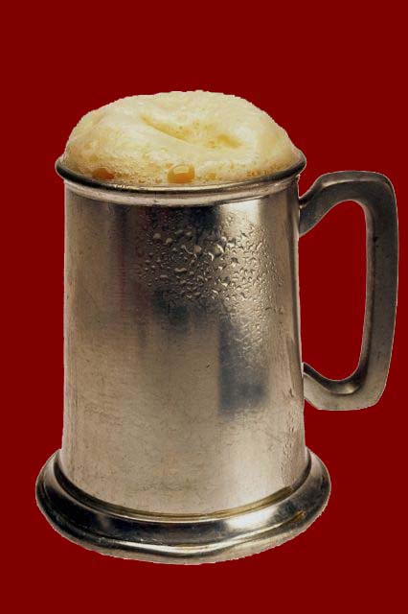
Food
You will not go hungry (often) in the army.
You and five of your mates will be given rations of the following daily.
- 2.7kg of bread or flour, 4.5kg of beef, 0.7kg of oatmeal and 2 pints of rum. It’s you job to share it with your pals.
Stew was one of the most popular choices men would cook.
We know our men well and so we provide daily beer money to enable you to relax over a pint with your mates. We give out free beer and other drinks before battle.

Slide 3
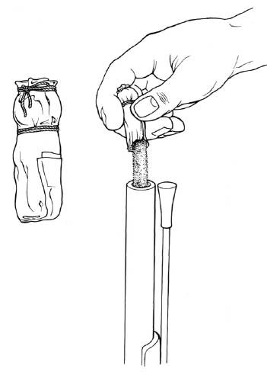
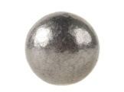
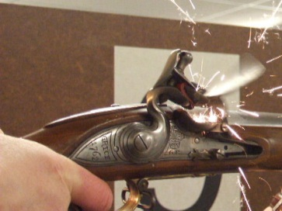
Weapon
Musket ball
The Brown Bess musket will be your best friend. It’s a simple but very effective weapon and a soldier should be able to fire 2 shots a minute. The best soldiers can fire 3!
To use the weapon you need paper cartridges filled with gunpowder and a musket ball. You can carry up to 60 of these.
The gun fires by flint (from Brandon) sparking and infighting the gunpowder. Very deadly!
Gunpowder
You also have a bayonet which is very useful on and off the battlefield. Many a Frog has come a cropper on the end of a Brown Bess with a bayonet!

Slide 4
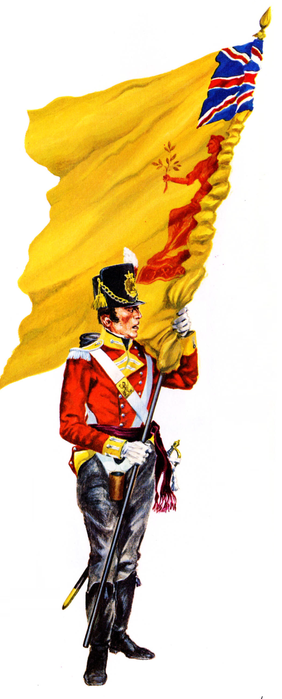
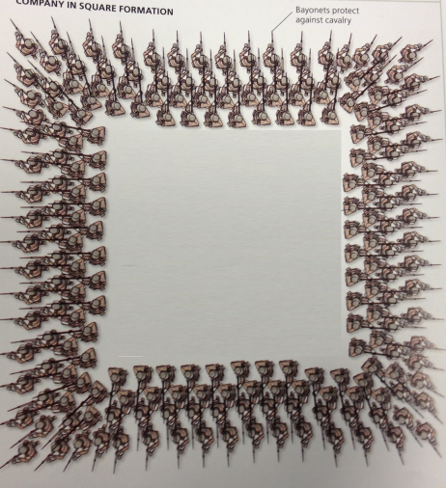
Combat
No one in the infantry is a lone hero. We work as a team or die!
We need to make sure we learn our drills well so that we can fight effectively. You must learn the line, and square formation. This will enable you to fight against infantry and cavalry. Your drill sergeant will teach you.
Square formation
Line formation
Can fire between 1000 and 1500 rounds per minute
This is called the colour and every regiment has one. Get to know your colour as you will fight to defend this with your life. If things start going badly wrong in battle then we will rally around this flag.

Slide 5
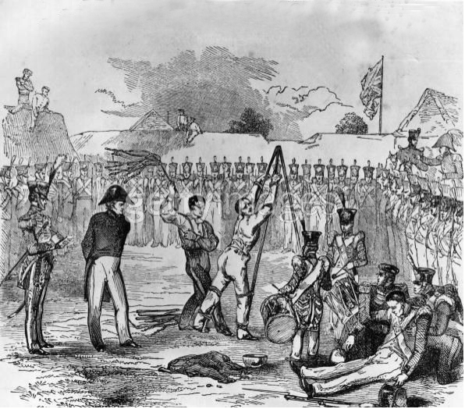
Punishment
This is never easy but never the less important. We live within the King’s Regulations. However sometimes soldiers have been known to break the rules.
If they do then we have some punishments to ‘help’ our men stay on the straight and narrow.
Most misdemeanours can be sorted out with the lash. Flogging is common and is carried out in front of the rest of the men to help them avoid committing the same offence!
Some crimes were more serious and required hanging. These included stealing from an officer, murder or sometimes it was used in lesser crimes to send out a message to the other men.
“Marched next morning, and passed one of our poor fellows, who had stolen some flour, hanging on a tree.” Private John Cooper

Slide 6
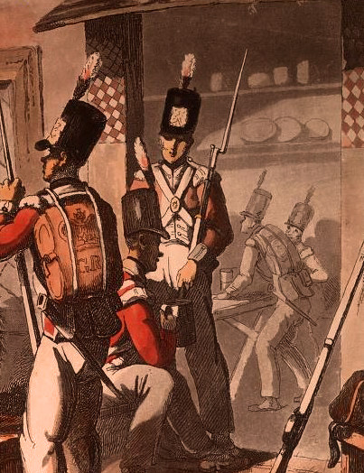
Daily Routine
The day starts early! Wake up at 4:30AM to the sound of the drum. Then a quick wash , of your hands, face, neck, and ears. This will be inspected! You then have time to clean your kit and quarters before first parade.
Then first parade at 5:15AM for inspection.
After this you went about your duties (individual jobs that each man did) and then returned to the mess for breakfast at 9:00AM.
11:00AM – The Troop (Full dress parade) where all kit is inspected and punishments given for incorrect uniform or a dirty musket.
Then lunch at 12:00 noon and an afternoon training, practicing fire drills and other duties until 6:00PM.
6:30PM dinner followed by evening prayers.
Lights out and register at 9:00PM.
Soldiers outside a public house. Drinking right after Morning inspection at 5:15AM was common.

