Slide 1
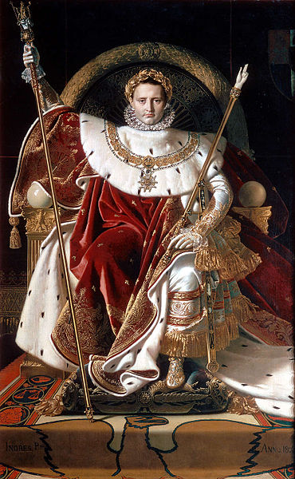

Slide 2
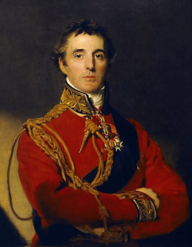
Who was the most successful general up until 1814: Wellington v Napoleon?
To identify and plot the main events of Wellington and Napoleon’s career
To explain and evaluate who was the greatest leader up until 1814

Slide 3
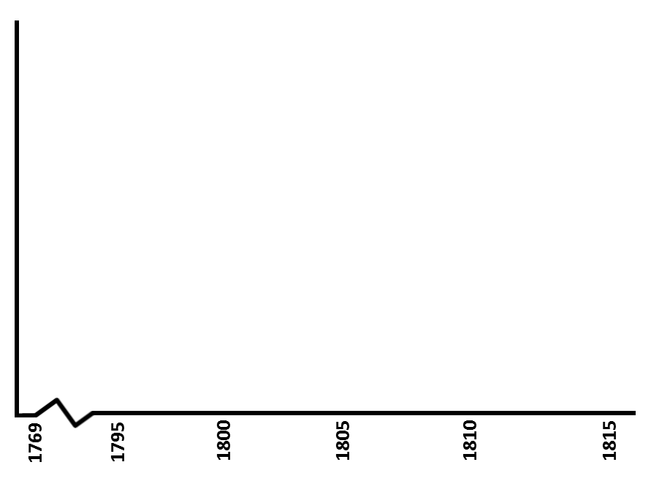
Napoleon
Wellington
Total Success
Total Failure
Notes:
This slide will need printing for each pupil – A3 size works best.

Slide 4
Using the evidence you’ve studied, who do you think was the most successful leader up until 1814?

