Slide 1
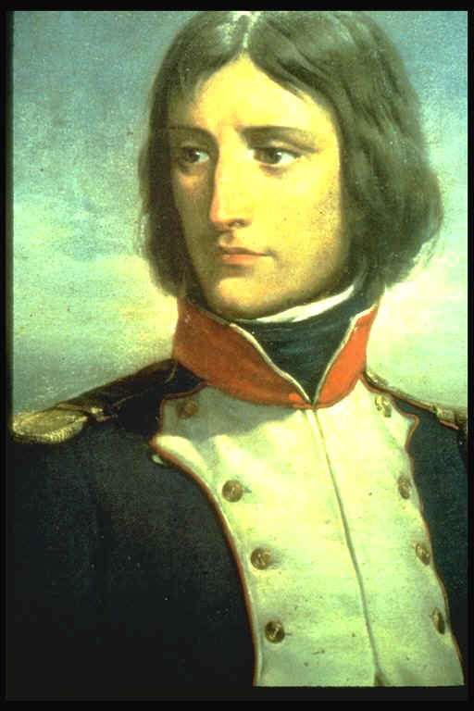
1769 – Napoleon was born to a poor noble family in Corsica.

Slide 2
1769 – Napoleon was born to a poor noble family in Corsica one year before it became a French territory. His family were anti-French but decided to send Nabulio (his family nickname) to Paris to a military school.
At school he excelled as an excellent student and graduated in 1785 as an officer in the artillery.
He was stationed in Paris and witnessed the French Revolution first hand.

Slide 3
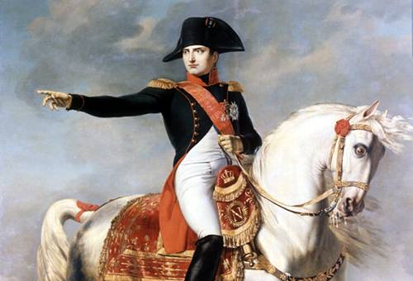
1795 – Promoted to General of the West.

Slide 4
1795 – Napoleon stood out to the new revolutionary government as being very talented. He put down rebellions against the new government.
He was quickly promoted, not just because of his talent but also because he wasn't from any particular French aristocratic family. He became General of the Western Armies within five years.

Slide 5
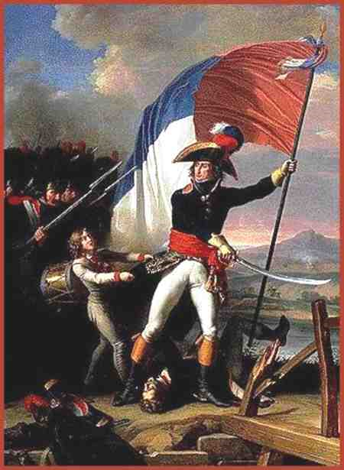
1796 – Napoleon wins the battles of Lodi, Arcole and Rivoli in Italy.

Slide 6
1796 – Despite not being well supplied Napoleon gained a reputation as an outstanding general, beating the Austrian Empire during the Italian campaign at the battles of Lodi, Arcole and Rivoli.

Slide 7
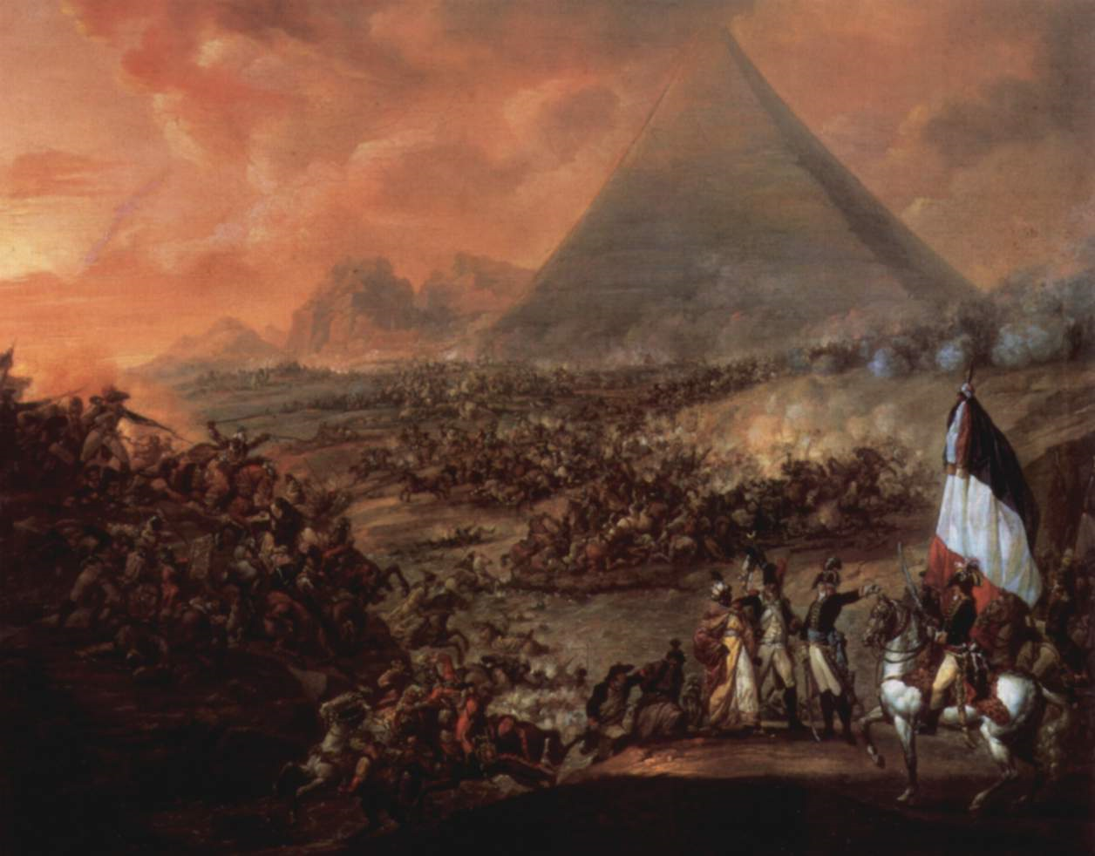
1798 – Napoleon won Battle of the Pyramids.

Slide 8
1798 – Napoleon then started his Egyptian campaign. He attacked the British and beat them.

Slide 9
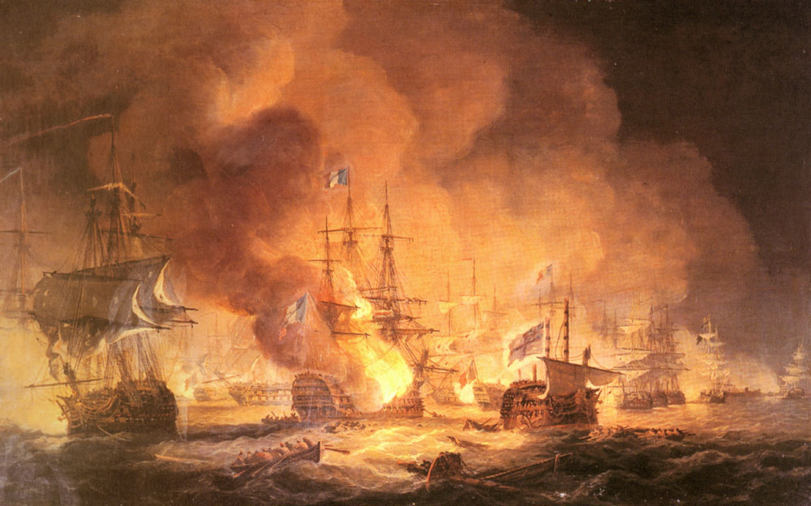
1798 – Napoleon loses his fleet to the British at the battle of the Nile.

Slide 10
1798 – Things start going badly for Napoleon in Egypt and he tried to retreat to France. However Nelson located his fleet and defeated them leaving Napoleon stranded in the Middle East.

Slide 11
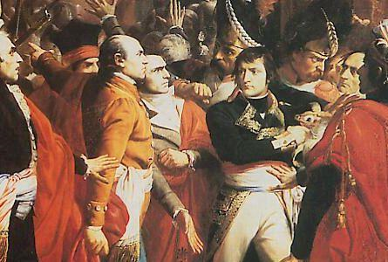
1799 – In France Napoleon launched a coup d’etat to become Consul (Head of Government)

Slide 12
1799 – Napoleon marched his men back to France. He returned furious that he was let down by the Republican government. The people welcomed him home as a hero.
He and his troops stormed the French Directory (equivalent to Parliament) and took over control of the government becoming consul (very similar to Prime Minister).

Slide 13
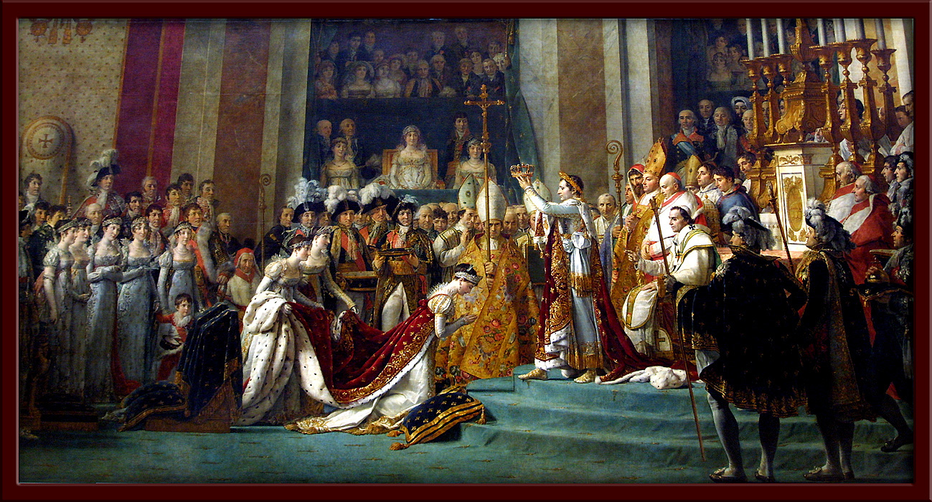
1804 – The French Senate proclaims Napoleon Emperor.

Slide 14
1804 – The French Senate proclaims Napoleon as Emperor of France. The people support him, having become tired with the weak and corrupt government of the Republic.
Napoleon is an international figure.

Slide 15
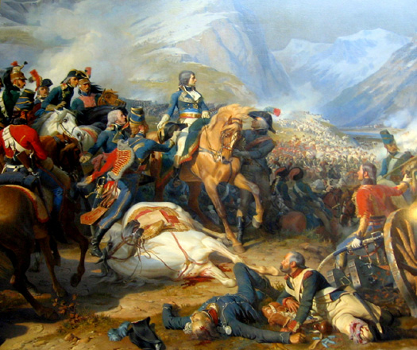
1808 – Napoleon sends soldiers to help his allies Spain defend the Portuguese boarder. He then turns on his ally and orders them to take all Spanish strongholds defeating Spain.

Slide 16
1808 – Napoleon sent an army to protect the borders of Portugal and then ordered them to conquer Spain. Napoleon is now in charge of France, Spain and Northern Italy.

Slide 17
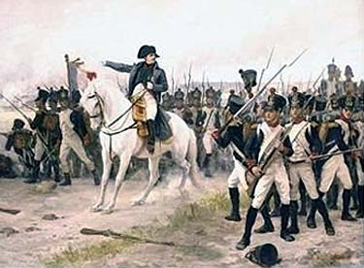
1812 – Invades Russia. A disastrous campaign where most of his army are killed in the harsh Russian winter.

Slide 18
1812 – Napoleon’s invasion of Russia started very well as he marched on Moscow and captured it. However, he couldn’t hold the city as the Russians burned it down rather then let him take it.
The Russian winter defeated the French army and many froze or starved to death on the march back to France.
Britain defeated the French in Spain in 1813.

Slide 19
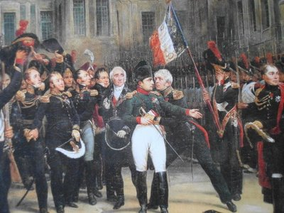
1814 – Coalition enters France to take Napoleon prisoner. He is exiled to the small Italian island of Elba.

Slide 20
1814 – Napoleon’s luck has run out and the coalition armies of Britain, Austria and Russia enter France and arrest Napoleon.
He is exiled to the island of Elba where he is supposed to live out the end of his life.
The French King Louis XVIII is given the throne.

